Slide 1
Disasters and (Im)Mobilities
12 Sept 2019

Slide 2
Key Terms
  Disaster: ‘A serious disruption of the functioning of a community or a society causing widespread human, material, economic or environmental losses which exceed the ability of the affected community or society to cope using its own resources.’ (UN ISDR, 2004 pp.16-17)
  Typically, disasters are understood to be:
    Episodic and rapid onset
    ‘Extraordinary’ events – NOT normal
    Mark the limit of human capacities

Slide 3
Context: recent hurricanes
Dorian (Sept 2019): Category 5, second-strongest storm on record
  (cat 5: sustained winds greater than 157mph)
  Thousands feared dead in Bahamas
  Monetary damages yet unknown
Maria (Sept-Oct 2017): Category 5
  Catastrophic damage to Dominica, PR, USVI; lesser antilles
  $91.6 billion (third-costliest Atlantic storm on record)
Irma (Aug-Sept 2017): Category 5
  Catastrophic damage to Antigua & Barbuda, PR, Cuba, Florida
  $77 billion (fourth-costliest Atlantic storm)

Slide 4
Disasters and the Anthropocene
Anthropocene
  New geological era: humans have become geological agents?
    Human activity impacts key Earth system processes
      Atmospheric cycle, hydrological cycle, nitrogen cycle…
  One effect: create increasing variance in extreme weather
    Location, frequency of droughts
    Strength of hurricanes
      Warmer surface temperatures = more energy in atmosphere = more energy released through high wind speeds in storms
      Effect on frequency scientifically uncertain

Slide 5
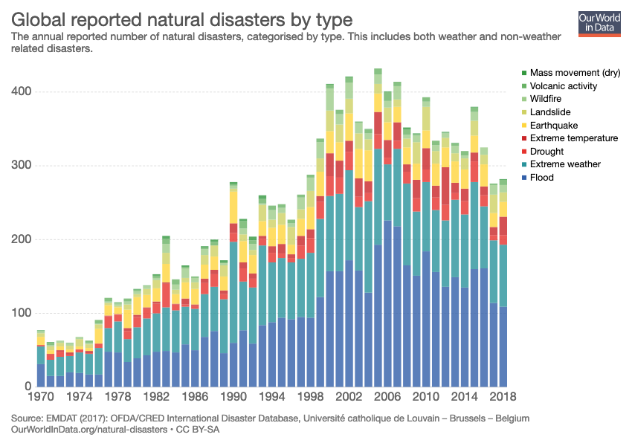
Disasters and the Anthropocene
Disasters have become more frequent…

Slide 6
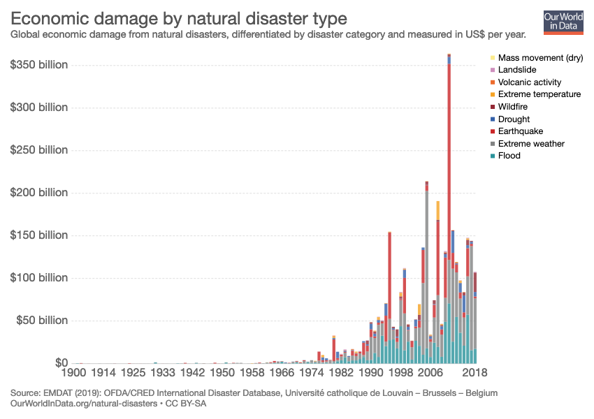
Disasters and the Anthropocene
And more costly…

Slide 7
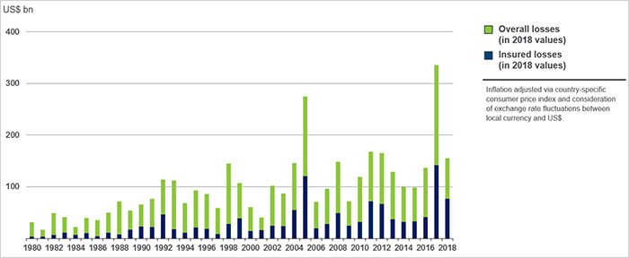
Disasters and the Anthropocene
Exceeding insurance, straining state and private budgets…

Slide 8
Key Trends
Economic losses due to disasters are increasing
Deaths from disasters are decreasing
  Due to better disaster management and risk mitigation
The number of disasters is increasing, due to:
  Better reporting (and more concern to report)
  Greater exposure to disaster
    Economic development in high-risk areas
    Population movements into high-risk areas
Contemporary patterns of development put more people at risk

Slide 9
Key Terms
  Hazard: ‘A potentially damaging physical event, phenomenon or human activity that may cause the loss of life or injury, property damage, social and economic disruption or environmental degradation.’ (UN ISDR, 2004 pp.16-17)
  Vulnerability: ‘A human condition or process resulting from physical, social, economic and environmental factors, which determine the likelihood and scale of damage from the impact of a given hazard.’ (UNDP, quoted in Birkmann ed. 2006: 15; my emphasis)

Slide 10
Disasters and the Anthropocene
In Caribbean: increasingly frequent Category 5 storms…
  1924-1998: 22 category 5 storms
  2003-2019: 17 category 5 storms
…causing damages that far exceed state capacities
  2004: Hurricane Ivan: 200% of GNP in Grenada
  2017: Irma and Maria: 230% of GNP in Dominica
  (GNP: Gross National Product, measure of country’s annual yearly economic output)

Slide 11
Disasters and the Anthropocene
“government of small island states… tied to multinational agreements”
  Reflects recent history of neoliberal development
Neoliberalism: counter-revolutionary response to Caribbean anti-colonial movements of 1960s, 1970s
  Debt, threat of sovereign default used to gain leverage over national governments
  Instituted mandatory policy prescriptions designed to make governments set economic policies in response to markets
    Privatization, deregulation, market liberalization, austerity
    States compete for offshore financial services, tourism

Slide 12
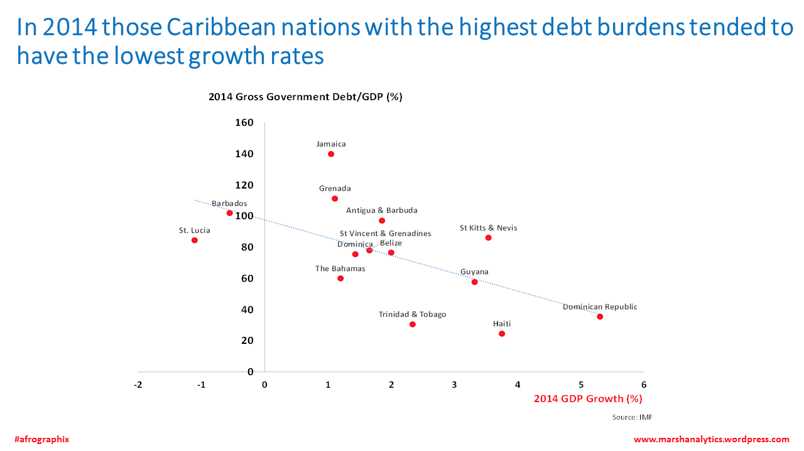
Effects of neoliberal development
  Opened region to limited foreign investment
    Export processing zones
    Tourism
    Offshoring
  Increased hardship for much of population
    Austerity cuts to social services
  Increased debt
    Structural adjustment loans

Slide 13
Effects of neoliberal development
State policies, development initiatives have been designed to placate international investors, international development agencies
  IMF (International Monetary Fund), World Bank, World Trade Organization
State does not (and usually cannot) design policies intended to increase social welfare
  Education, health, utilities (for the public): seen as “unproductive”, wasteful, inefficient spending to development agencies

Slide 14
Effects of neoliberal development
Impact on disaster preparedness and disaster response
  States divested of some infrastructure; private corporations will not invest in critical maintenance
    Telecommunications, roads, ports – all required for efficient response
  States cannot finance disaster losses
    Emergence of new insurance products
    Bahamas 1992 (see Grove 2012, Security Dialogue)
  Shift in disaster relief
    Shift away from grants to loans
      Loans tied to conditionalities

Slide 15
Impact of disasters on development
Disasters destroy critical infrastructure financed through development loans
  States cannot earn income from infrastructure to pay down loans
Deters investment
  Hazard risk ‘one of several undesirable factors’ limiting foreign investment (Portia Simpson-Miller, 2006 meeting of Caribbean Development Bank
Threatens disorder (?)
  Leaders assert disasters could lead to social breakdown... But there are no actual examples of this

Slide 16
You tell us…
Working in a group, select one country that has been impacted by recent disasters.
  Identify:
    One major disaster event that impacted your country
    One article summarizing this event (email to me at kgrove@fiu.edu
    Summarize its social and economic impacts

